Slide 1
Beer Analysis
By Shimin

Slide 2
Background Overview
Background:
The Tax Cuts and Jobs Acts, passed by Congress in December 2017, provided a temporary reduction in federal excise taxes for all brewers and beer importers.
Impacts:
99% of U.S. breweries’ excise tax payments were reduced by 50%.
Large and regional beer suppliers, which jointly provide 58% of beer’s direct brewing jobs, saw their excise tax payments reduced by an average of 3%.
Regulation/Federal Tax :
$3.50 per barrel on the first 60,000 barrels for domestic brewers producing fewer than two million barrels annually;
$16 per barrel on the first six million barrels for all other brewers and all beer importers; and
$18 per barrel rate for barrelage over six million.

Slide 3
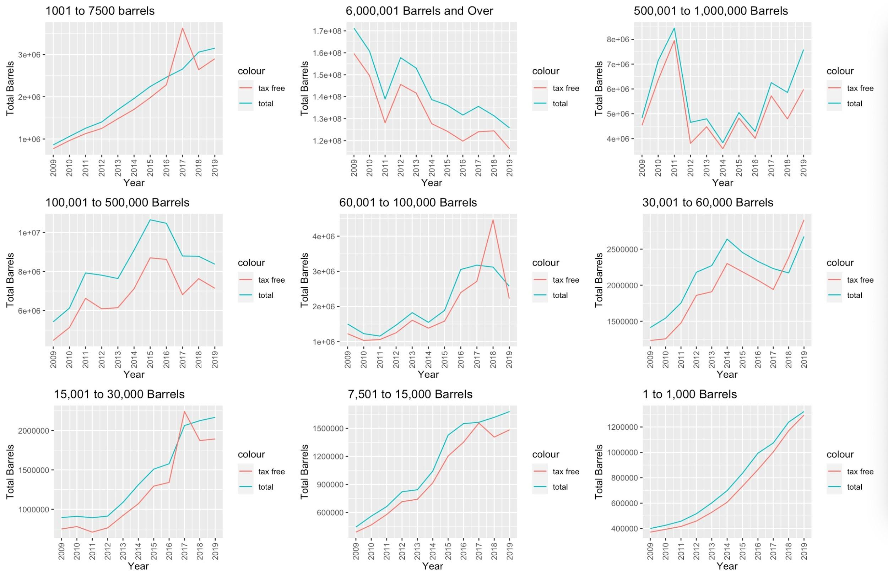
From here, we can see for most brewer size, total barrels constantly increase despite for 6 M barrels. This could also be impacted by federal tax before.

Slide 4
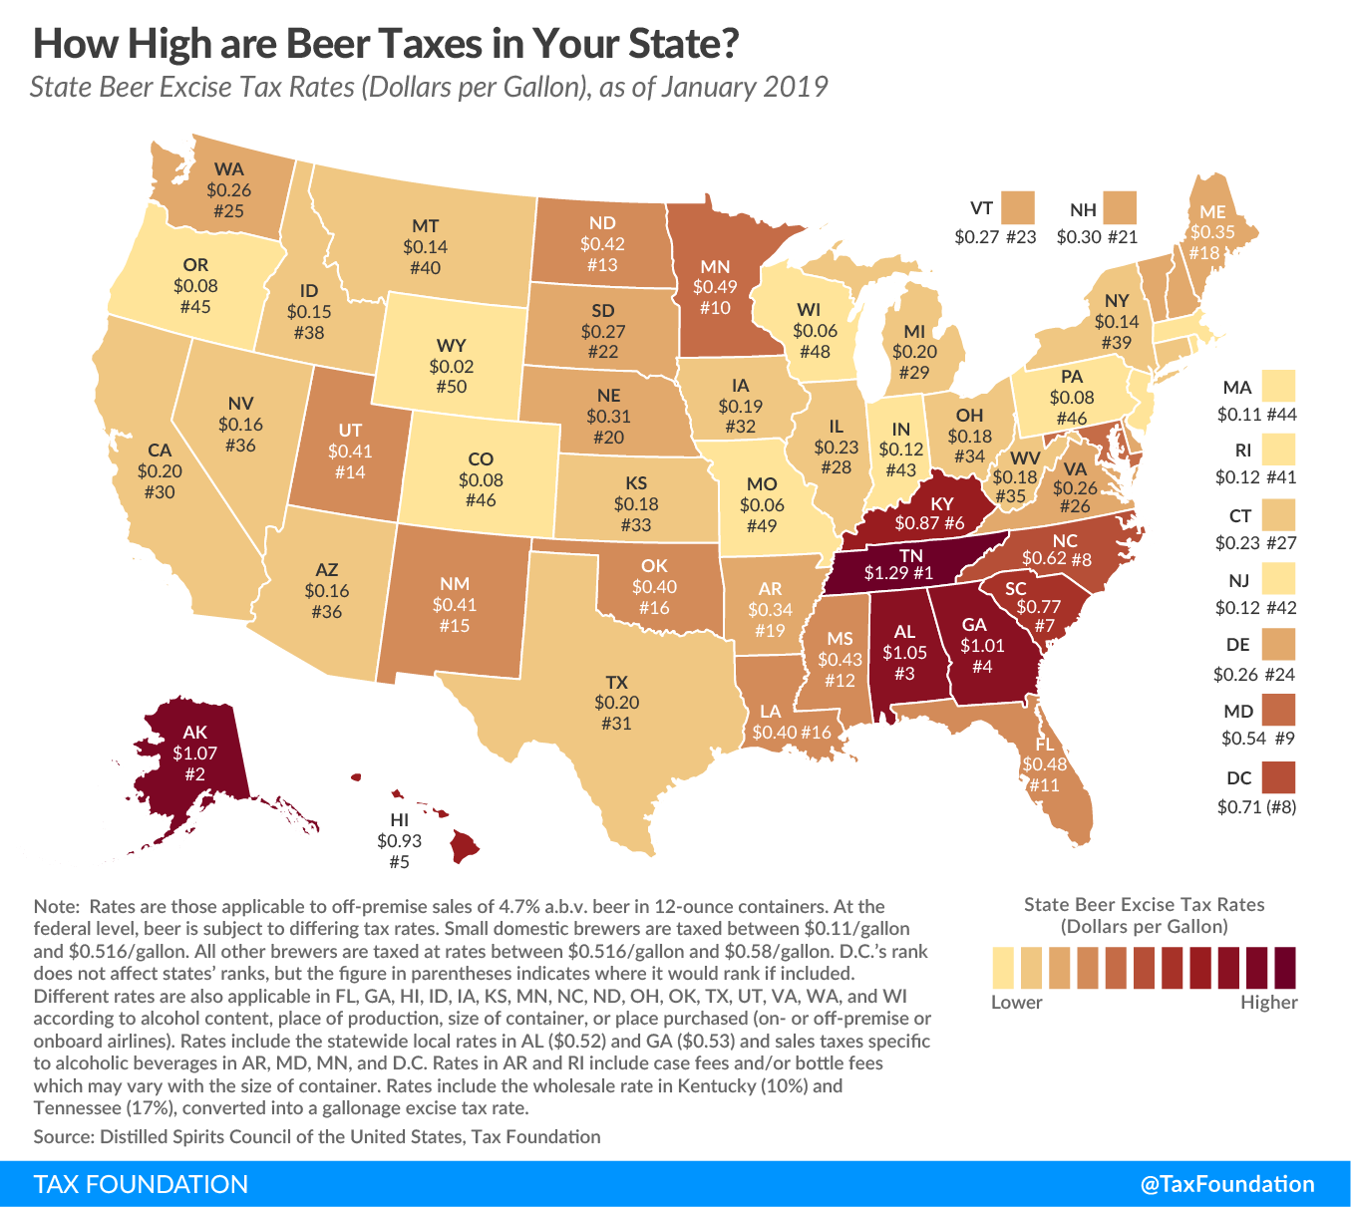
Tax and Total Barrels
According to the Beer Institute, “Taxes are the single most expensive ingredient in beer, costing more than the labor and raw materials combined.” Research has shown that approximately 40%of the retail price of beer is dedicated toward covering all the applicable taxes.
"CA" "CO" "FL" "GA" "MO" "NC" "NJ" "NY" "OH" "PA" "TX" "VA" "WI"
Here are states that has high total barrels among all states. We can see that all of these states has relatively low state tax on beer.

Slide 5
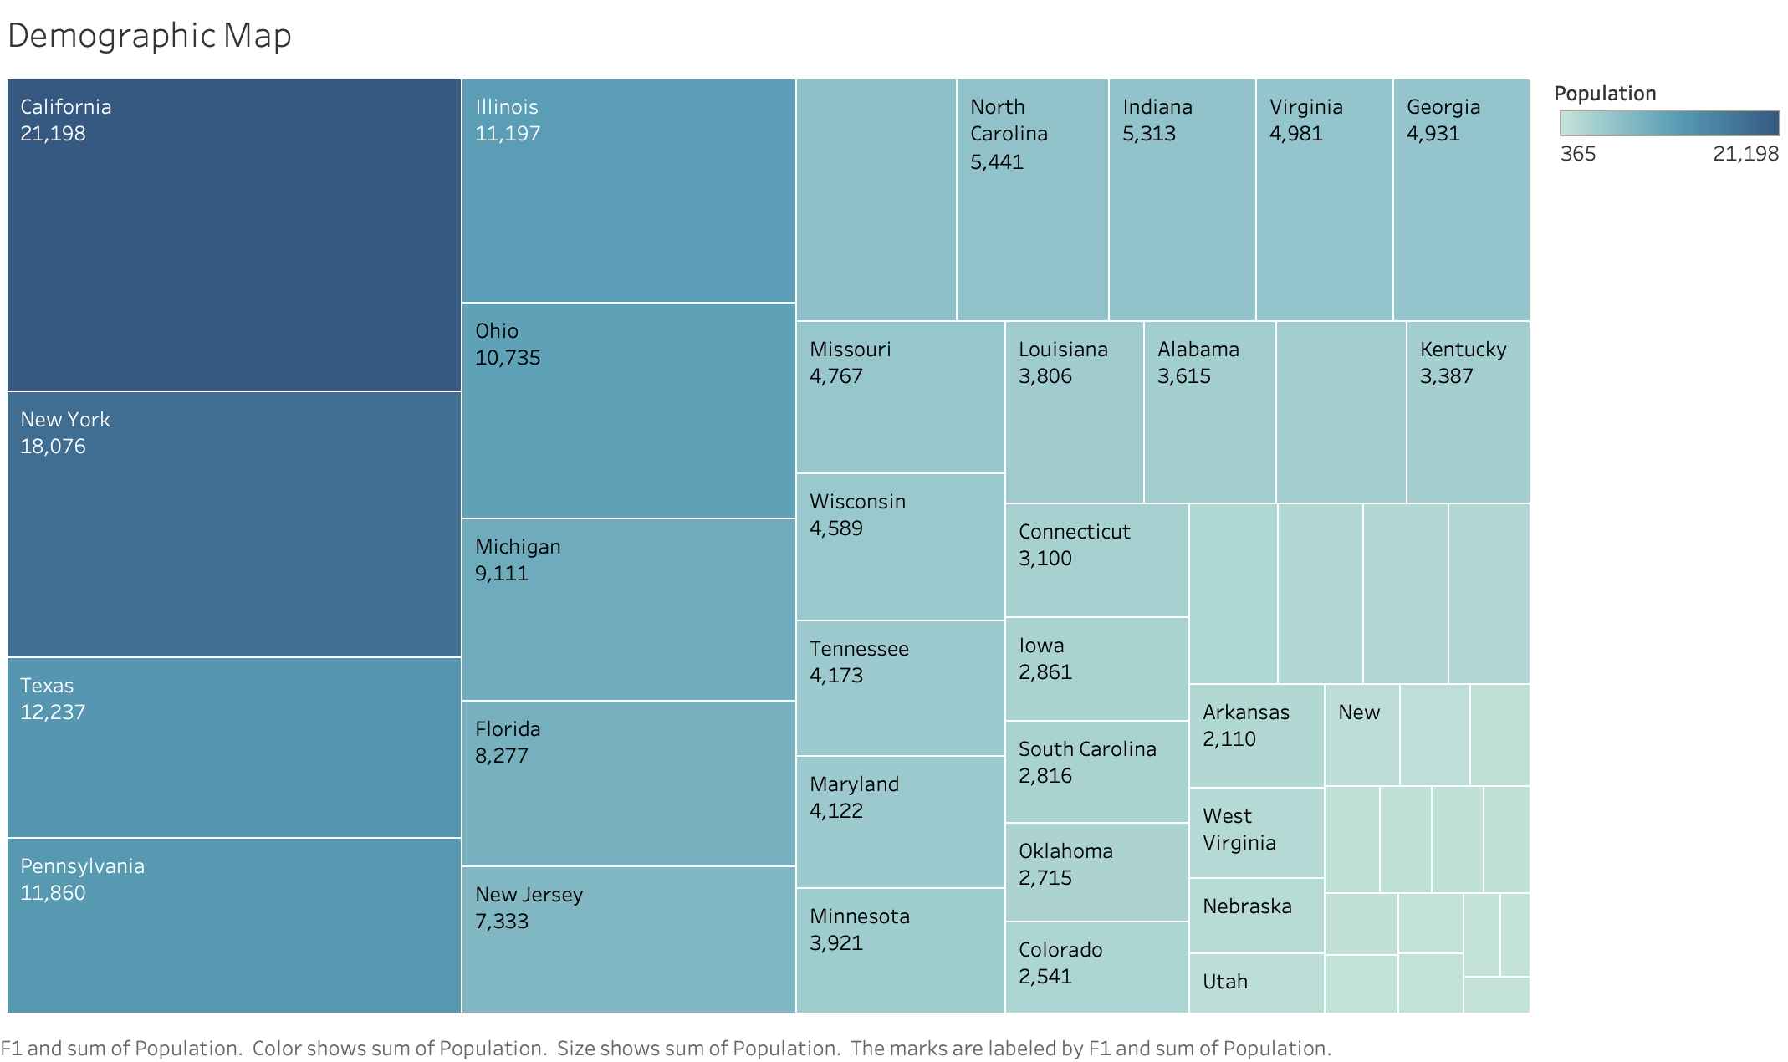
Population and Total Barrels
Another factor that could further impact total barrels is population.
CA, CO, OH, TX are the four leading states deducted from datasets here that has highest total barrels, most of these states has higher population compared to other states.

Slide 6
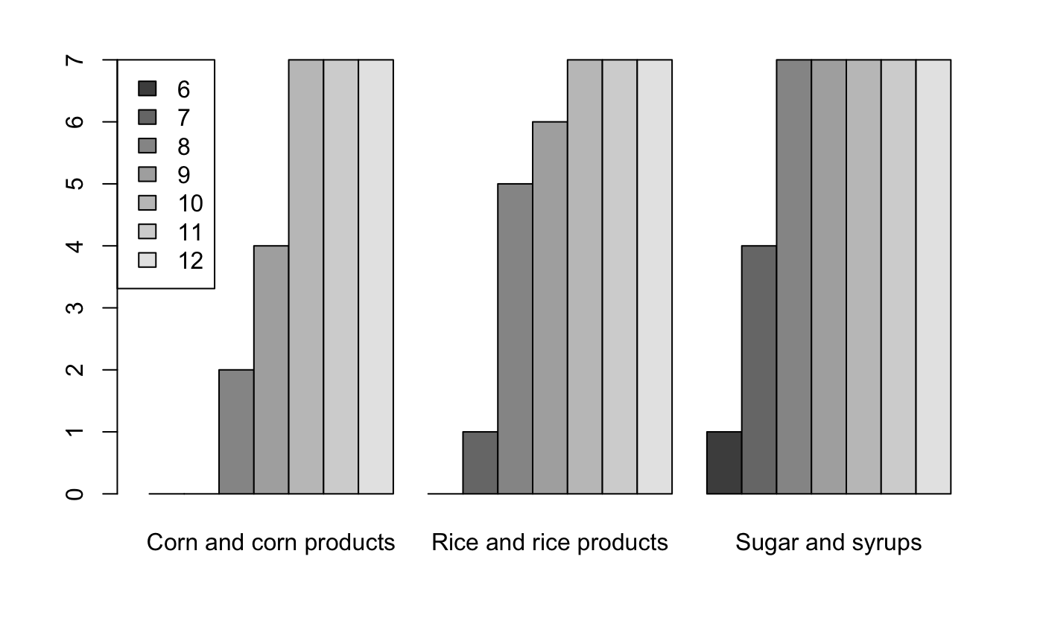
Beer Materials
Malt materials dominant in the market overall.
For other materials, By further investigating in this area we find that only sugar, corn and rice has volume(ytd) over 5e+08, I would like to investigate in this section more to see if there is any difference in volume on different month/year. (6,7,8,9..) represents month
Generally, volume increases from Jun to Dec constantly. All entries that has ytd value that over boundaries are within Jun-Dec timeframe. For corn and rice, there is no big difference from October to December. For sugar, it dominates the market from August all the way to December. Now let's get back to Malt materials and check details of this dominant material in the market.

Slide 7
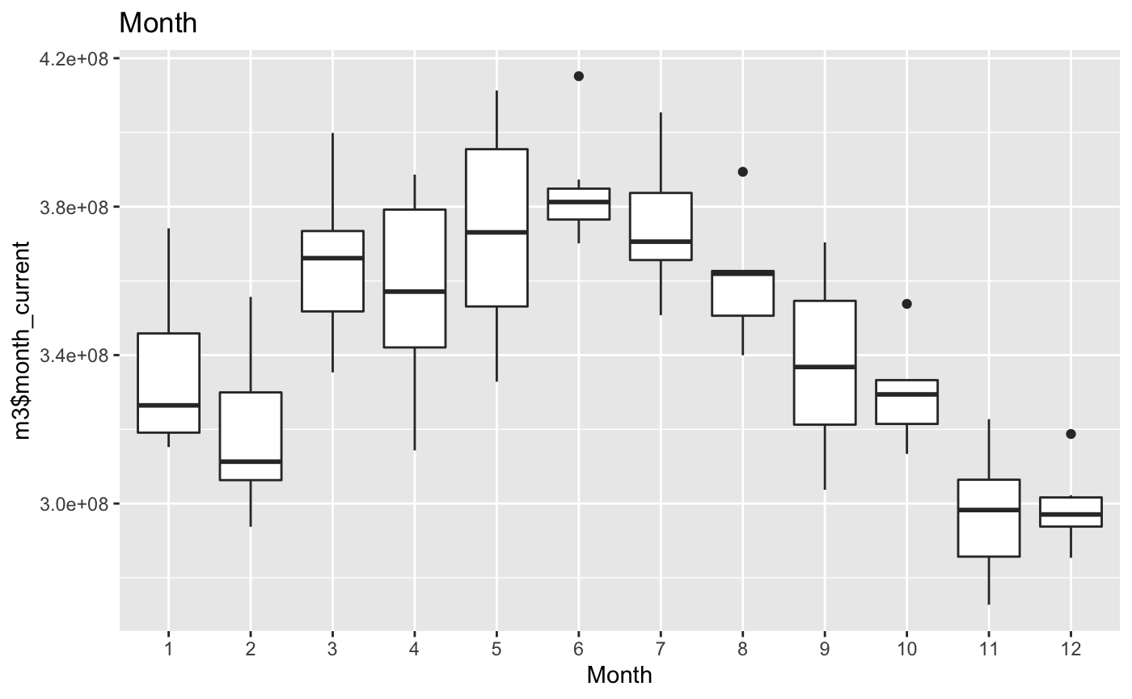
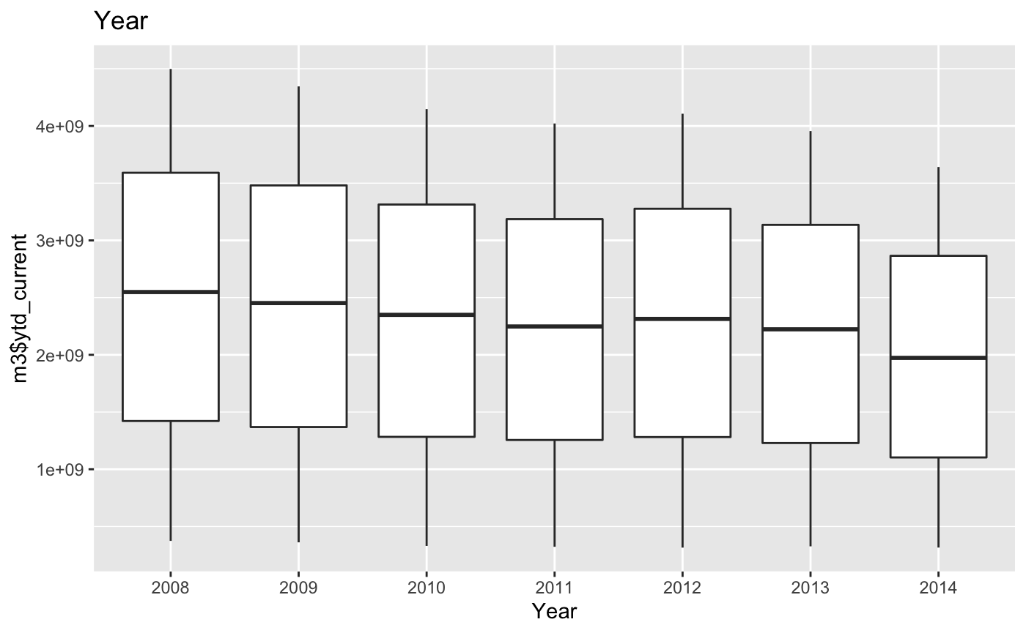
Malt Materials
Back on current dominant materials on the market, Interestingly enough, we can see that there is an reverse than on malt materials brewer compared to all other categories. From year to year, there is slight decrease trend but that tend is not very obvious. There is potential that malt materials are replaced by other materials overtime but more evidence and research need to perform on that. However, on month trend pic,there is a increasing trend from January to June and decreases since then.It reaches lowest point during December, while at the same time all other categories are increasing from Jun.

Slide 8
Underlying Insights
Of course, Beer with malt materials is still dominant the market but we can see a niche market with other materials emerging over these years. There are several reasons why some brewers may choose to produce beer with rice, corn or sugar.
They could make color lighter while they use rice or corn to make beer. Light-colored beer is very popular these days and brewers are willing to adjust based upon.
Corn, rice and sugar are used as adjunct grains in fermentation process. The rise in craft brewers has led to more small-batch beers produced with adjunct grains and other ingredients.
Corn adds a slightly sweet smoothness to the beer and is often included in light lagers and cream-style ales

Slide 9
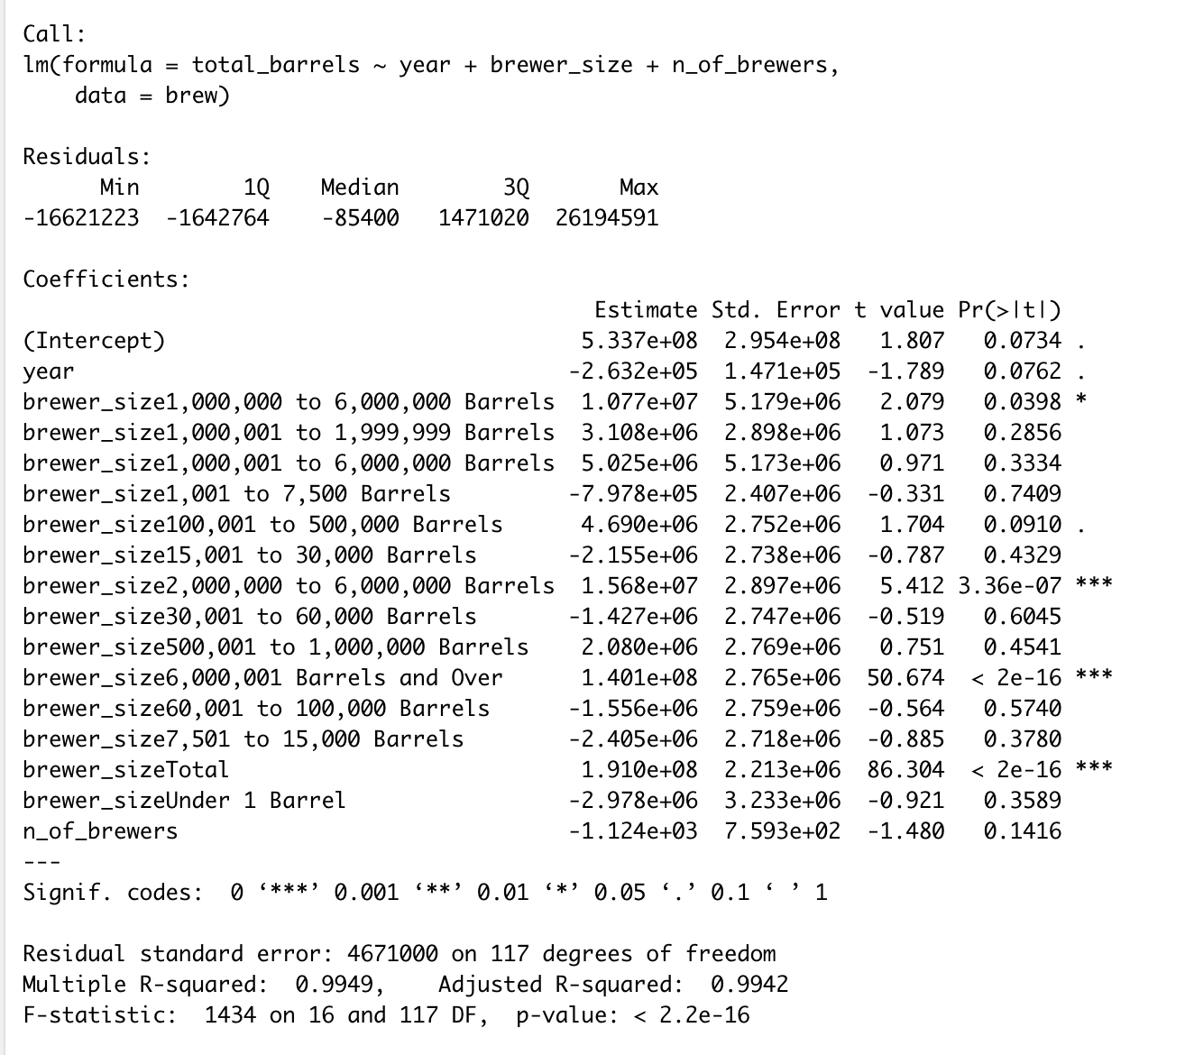
Regression Model on Brewer.csv
I applied linear regression model to check coefficients and significance level of different factors here. It further proof my previous assumption of impacts of brewer size on total barrels.

Slide 10
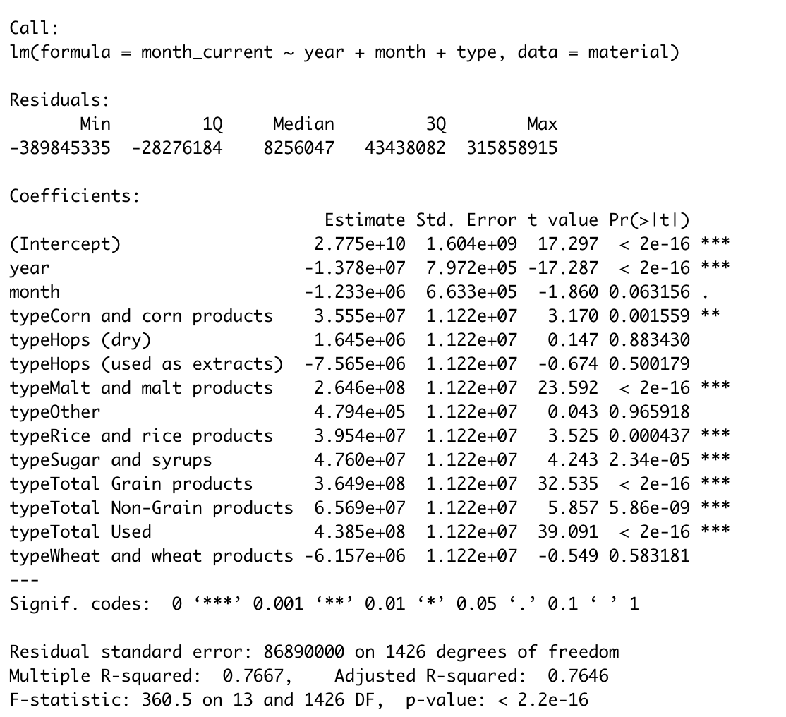
Regression Model on Material.csv
Same as the above slide, I applied linear regression model to check coefficients and significance level of different factors here. The findings from models compatible what we conclude from previous data.

